Slide 1
Public Policy and Wholesale Markets
Stu Bresler
Senior Vice President – Operations and Markets
PJM Interconnection, LLC
Energy Policy Roundtable
December 1, 2016

Slide 2
Key Question
Can we rely on PJM’s organized wholesale electricity market to efficiently and reliably manage the entry and exit of supply resources as external forces create tremendous uncertainty and potential industry transformation?

Slide 3
Resource Exit
This is the claim. . .
“[P]oorly structured electricity markets are putting at risk other well-operated, proven nuclear-energy facilities in New York, Ohio, Illinois and other states. Once closed, these plants won’t reopen. We must act now before it is too late.”
Christine Todd-Whitman, WSJ (2015)
First Energy is seeking a power purchase agreement to “prevent plants from retiring before it is economic to do so.”
Deposition Testimony, Larry Makovich, Public Utilities Commission Ohio (2015)

Slide 4
Concerns Expressed with Markets Signaling Gas
Economic - spot market; short sighted; gas prices will rise
Reliability - operational security concerns given “just in time” delivery
Reliability - long term adequacy; black swan events
Environmental Policy - loss of zero emission resources (nukes)
Social/Political Policies - jobs, local economic vitality, etc.
Conclusion: the most economically efficient resource portfolio to meet reliability
≠
“best” portfolio in the eyes of policymakers
Notes:
Illustrated graphically with out-of-market PPA example

Slide 5
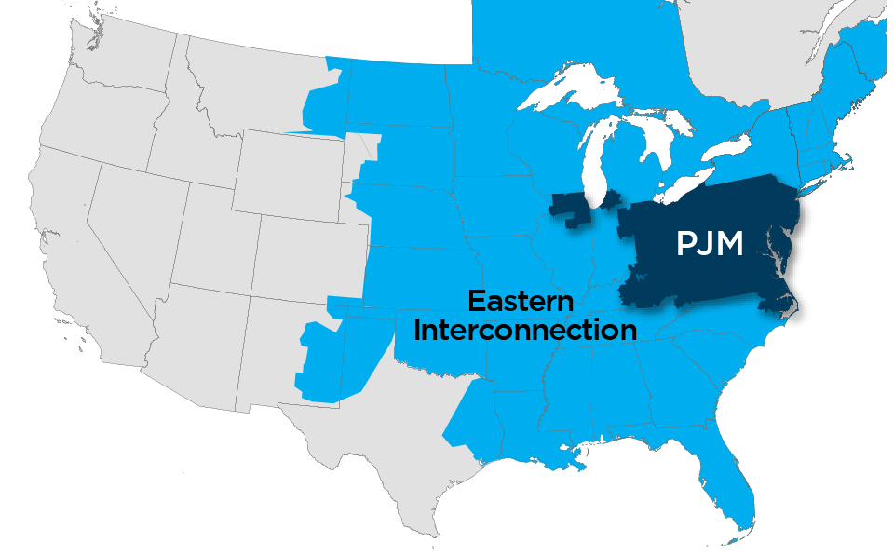
Federalism Tension
Public policy goals of
federally approved wholesale markets
v.
Other public policy goals at a state
and local level

Slide 6
SCOTUS - Hughes Case
Nominally a “win” for wholesale markets – preemption of state subsidy programs “tethered” to the wholesale market.
Appreciate the mandatory and comprehensive nature of PJM capacity market???
Narrow application; instruct states how and how not to design their subsidy programs.
PJM View: Hughes not relevant to plans to forge a more workable coexistence between wholesale market goals with state public policy goals.
- Fighting state programs not a legally or politically sound approach

Slide 7
Future
Assumptions:
Hopeful (but realistic) on the prospects for national or regional consensus
Anticipate that individual states will act
PJM Thinking:
Open to adjusting the scope of the capacity market
2 Principles:
Do not frustrate states from taking policy actions
But ensure prices that issue from capacity market remain competitive

Slide 8
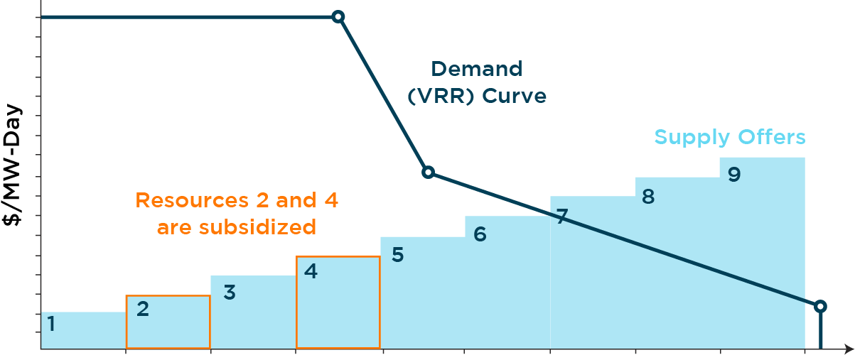
Offered Supply and Demand Curve

Slide 9
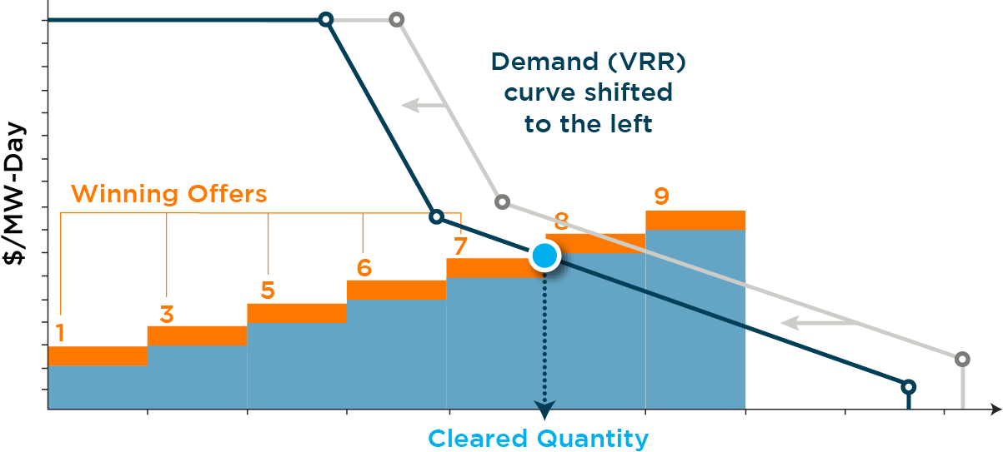
Stage 1: Subsidized Supply Offers and Equivalent Demand Removed

Slide 10
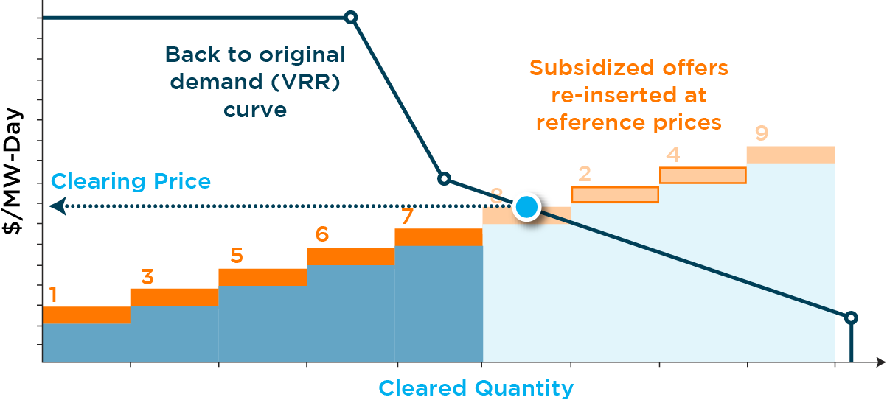
Stage 2: Subsidized Offers Re-Introduced at Reference Prices; Original Demand Curve Used

